Slide 1
Generalised Linear Models in R
Workshop for IEA 2019
09/01/2018
Ruth Kelly - Trinity College Dublin
kellyr44@tcd.ie
Image by Jason Auch

Slide 2
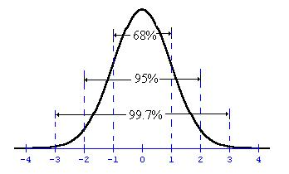
Generalized Linear Models in R
a.k.a. What to do when things are not normal…
Notes:
Mention that there are lots of mathematical distributions which describe natural processes. - Next week we’ll talk about distributions for proportion and survival data. This week count data..

Slide 3
Anatomy of a Generalized Linear Model
Linear predictors
Error structure
Link function
y = α + βx …

Slide 4
Anatomy of a Generalized Linear Model
Linear predictors
Error structure
Link function
y = α + βx …

Slide 5
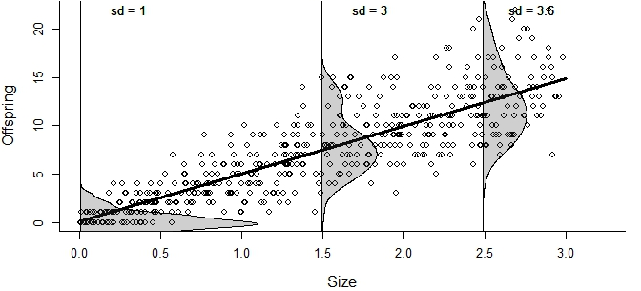
Anatomy of a Generalized Linear Model
Linear predictors
Error structure
Link function
y = α + βx …

Slide 6

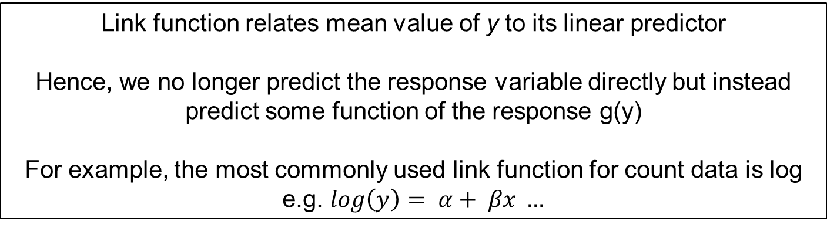
Anatomy of a Generalized Linear Model
Linear predictors
Error structure
Link function
y = α + βx …
$$g\left(y\right)= α+ βx ..$$
Link function relates mean value of y to its linear predictor
Hence, we no longer predict the response variable directly but instead predict some function of the response g(y)
For example, the most commonly used link function for count data is log
e.g. $log\left(y\right)= α+ βx …$

Slide 7
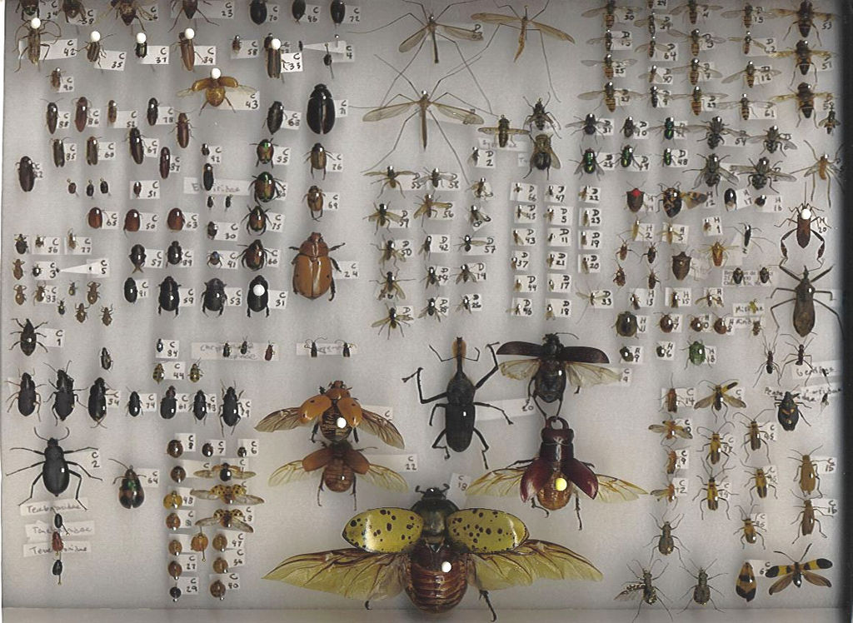
Count data
Coleoptera collection - Image by Debivort

Slide 8
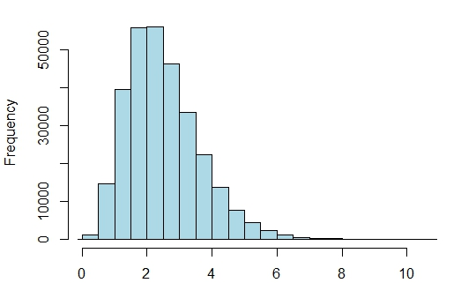
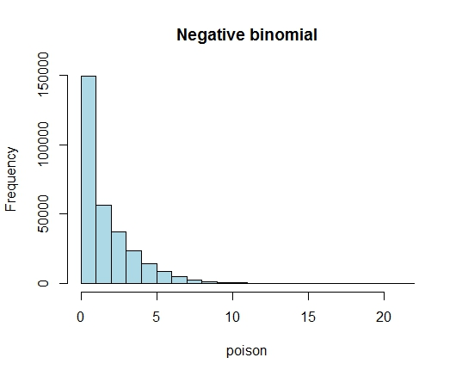
Generalized Linear Models in R
Distributions for count data
Poisson distribution
Negative binomial distribution
Notes:
Today’s lecture will teach you how to model data which is not normally distributed. This is very common in ecology, and there is an extension to Linear Models designed to deal with this problem. These are known as Generalized Linear Models.
Todays’ lecture –
- Brief recap of the assumptions of these models
- Introduction to the components of a Generalized Linear Models
- Discussion of the

Slide 9
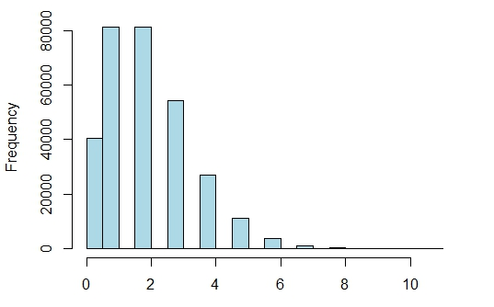
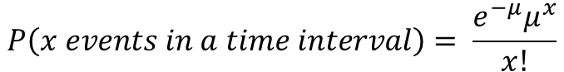
Poisson distribution
$$P\left(x events in a time interval\right)= \frac{e^{−μ}μ^{x}}{x!}$$
Bounded at zero
Whole numbers only
Notes:
Generate poisson distribution from birthdays in the class here..

Slide 10
Running a Generalized Linear Model in R
Function ‘glm’
Specify a family and a link function
eg. glm(dependent variable~Explanatory variable,
data = datasheet, family = “poisson”(link = log))

Slide 11
Poisson distribution assumption
Bounded at zero
Whole numbers only
Mean = variance

Slide 12
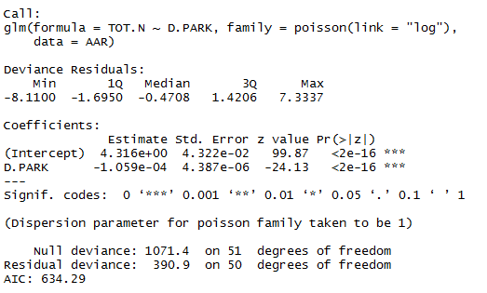
Checking Poisson Mean Variance Assumption
Divide Residual Deviance of model by Residual degrees of freedom this should be close to 1 and definitely not greater than 2

Slide 13
Checking Poisson Assumption
Divide Residual Deviance of model by Residual degrees of freedom this should be close to 1 and definitely not greater than 2
390.9 / 50 = 7.8
Poisson assumption not met!

Slide 14
Negative binomial distribution
For count data where variance > mean
i.e. assumption of Poisson is not met
Bounded at zero
Whole numbers only
Variance can be > mean
For “overdispersed”/”long-tailed” data

Slide 15
Running a ‘negative binomial’ Generalized Linear Model in R
Function ‘glm.nb’ (package = “mass”)
Family is automatically set for negative binomial, set link to ‘log’
eg. glm.nb(dependent variable~Explanatory variable, data = datasheet, link = log)

Slide 16

Too many zeros?
Image by Shulman

Slide 17
Too many zeros?
You may need a zero-inflated model,
you can fit these similarly in the package “glmmTMB”
Image by Shulman

Slide 18

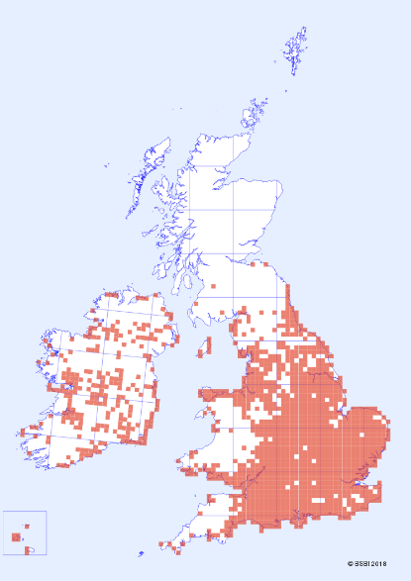

Proportion data and presence/absence
Image from http://cyberbridge.mcb.harvard.edu/
Image © The Crane Valley Partnership 2016
Bee orchid - Ophrys apifera, Image by Tuxyso

Slide 19
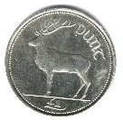
Proportion data arises from a binomial process
A binomial process
2 possible outcomes
Repeated trials
Probability of success is constant
Trials are independent

Slide 20
Proportion data arises from a binomial process
A binomial process
2 possible outcomes
Repeated trials
Probability of success is constant
Trials are independent
We are interested in the probability of a given number of successes

Slide 21
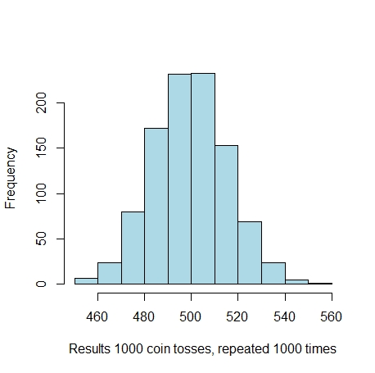
Proportion data arises from a binomial process
We are interested in the probability of a given number of successes

Slide 22
Running a Generalized Linear Model using Proportion data in R
Specify a family and a link function
eg. glm(response variable ~ Explanatory variable,
data = datasheet,
family = “binomial”(link = logit))

Slide 23
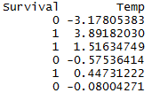
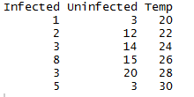
Response variables in a Generalized Linear Model with Proportion data in R
Note: the response variable may have either of two formats depending on your data
For 0’s and 1’s of individual attempts, response is a single column
For counts of successes and failures per trial, response is two columns
glm(Survival ~ Temp,
data = datasheet,
family = “binomial”(link = logit))
glm(cbind(Infected, Uninfected) ~ Temp,
data = datasheet,
family = “binomial”(link = logit))

Slide 24

Warning: Percentages are different from proportion data
%’s are not easily modelled as a binomial process
Number of trials is unclear
eg percentages may come from different sample sizes or areas.

Slide 25
Warning: Percentages are different from proportion data
%’s are not easily modelled as a binomial process
With percentage data it is best to pre-transform the data with a logit transformation to make it linear, and then use a standard Linear Model
For further details see Warton & Hui (2011) The arcsine is asinine: the analysis of proportions in ecology. Ecology 92:3-10

Slide 26


Great books for glms

Slide 27
